Slide 1

TARGET EQUITY ANALYSIS

Slide 2
Agenda
Recommendations
The Economic Environment
The Industry Environment
Company Analysis
Final Recommendations
Q&A

Slide 3

Recommendations
Company | Target Corporation
Ticker | TGT
Current Price | $120.18
Valuation Price | $133.27
Recommendation | Buy

Slide 4
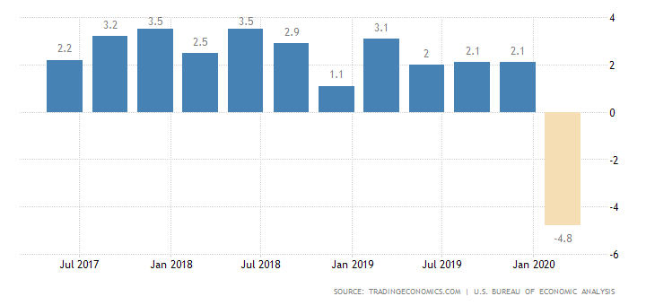
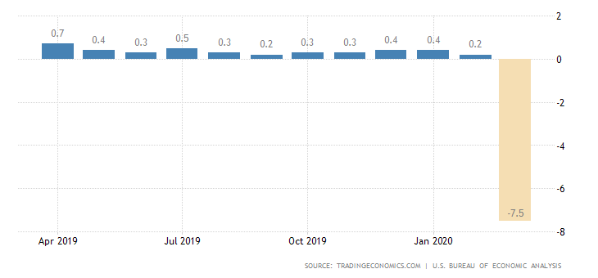
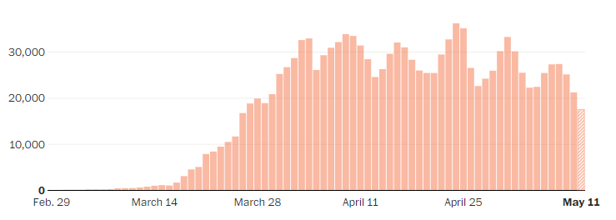
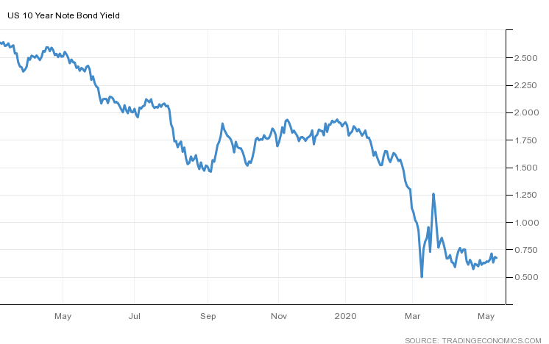
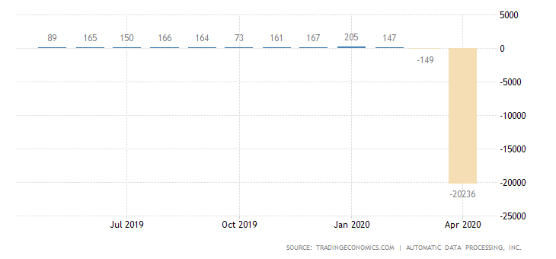
Economic Environment: Spring 2020
GDP Quarterly Growth Rate
United States Personal Spending Rates Month-to Month
Key Economic Indicators:
GDP Growth
Jobs Gained/Lost
Personal Spending
Interest Rates
Corona Virus Cases - US
Total US Coronavirus Cases Reported per Day
United States Employment Change by Month
Notes:
https://tradingeconomics.com/united-states/gdp-growth
https://tradingeconomics.com/united-states/adp-employment-change

Slide 5
Economic Environment: Spring 2020
Additional Indicators:
Consumer Confidence
Unemployment Rate
Personal Saving
Consumer Price Index (CPI)
New Home Sales
Outlook:
CCI dropped from 101 in February to 71.8 in April
Unemployment up to 14.4% from 3.5% in February
Consumers saving more money - up to 13.1% of disposable income. Highest since 1981
CPI down .42%
New Home Sales down 19.3% from January
Notes:
https://tradingeconomics.com/united-states/consumer-confidence
https://tradingeconomics.com/united-states/personal-savings
https://www.cnn.com/2020/04/30/investing/savings-rate-federal-reserve/index.html

Slide 6
Economic Conclusions
As a result of the global pandemic Covid-19, economic growth has been severely damaged both in the short-term and long-term
Record high unemployment rate (~20%) is indication how badly individuals personal incomes are hurting
With many consumer goods stores closing for the short-term, consumers do not have anywhere to enter the economy and thus are saving at an extreme rate, as also seen in consumer spending.
Need to watch for states reopening and loosening Covid-19 measures and how cases develop in those areas. If we see second spike, likely to see a recession in economic growth again.

Slide 7
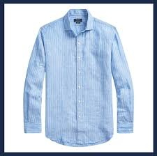
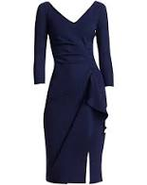
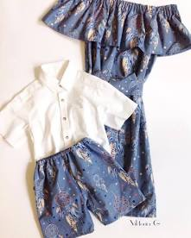
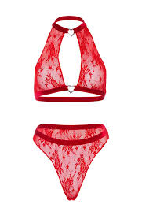


Industry Analysis
Different outlooks for different industries
Men’s
Women’s
Family
Lingerie
Accessories
E-Comm
Size ($B):
Est. Annualized growth:
8.5
37.5
115.7
19.1
16.5
486.4
-2.5%
-2.8%
+2%
+1.8%
+2.6%
+9.1%

Slide 8
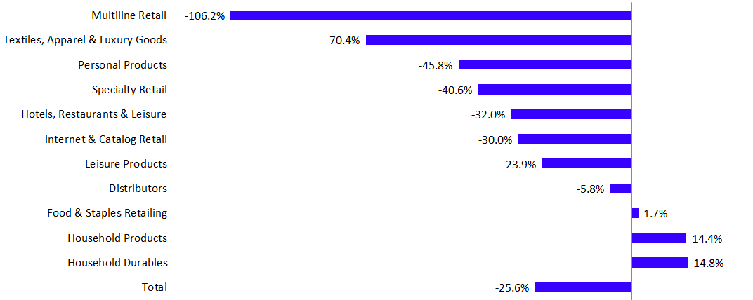
Industry Analysis
Target serves mature markets in a phase of consolidation
E-Commerce growth might compensate for declining categories
Luxury segments (or higher priced, niche items in general) have mostly performed better than clothing staples
FX, Liquidity, and Regulatory concerns affect all three firms
The Retail Earnings Growth Rate - Q1 2020
https://seekingalpha.com/article/4345773-u-s-consumer-spending-preview-q1-2020?utm_source=thomsonreuters.com&utm_medium=referral

Slide 9
Company Analysis - Target Corp.
Agenda
Management and Corporate Governance
Strategy and Positioning
Red Flag Analysis
Risks and Contingencies
SWOT Analysis
Ratio and Trend Analysis
Valuations
Market Consensus
Recommendation
Financial Market Cap: $57.895B Revenue: 78.112B Net Margin: 4.2% | Revenue Mix Apparel and Accessories: 14.304B Beauty and household essentials: 20.616B Food and beverage: 15.039B Hardlines: 12.595B Home furnishings: 14.430B
Operations Number of Stores: 1,868 Store Sq. Feet: 240 million Number of Employees: 368,000 million | Global Coverage Nearly all revenues are generated within the U.S.
Notes:
https://www.gapinc.com/content/attachments/gapinc/GPSEarnings/Global%20Footprint.pdf

Slide 10


Target Corp. - Management and Governance
Board of Directors
Roxanne Austin, President
13 member board
9 industries represented
Executive Leadership
Diverse 12 member leadership (7 men, 5 women)
Brian Cornell, Board Chairman and CEO
Corporate Governance
Board Committee’s include - Audit & Finance, Governance, Human Resources & Compensation, Infrastructure & Investment, and Risk & Compliance.

Slide 11
Target Corp. - Strategy and Positioning
Financial Strategy
Invest in opportunities to profitably grow business and create sustainable long-term value, while maintaining current operations and assets.
Maintain a competitive quarterly dividend and seek to grow it annually.
Return any excess cash to shareholders by repurchasing shares within the limits of credit ratings goals.
Industry Leading Ratios: Net Margins (4.2%) Operating Margin (6.0%) ROA (7.8%)
Product Offering | Omni-Channel Approach | Distribution Centers | Highlighting growth via guest experience
Offers everyday essentials and fashionable, differentiated merchandise at discounted prices. | Brick & Mortar, Online Sales, Franchise agreements. | Distribution network mix allows for reduced shipping costs, high product availability and fast delivery times. | Store remodeling, new owned and exclusive brands, smaller stores format, and same-day service.

Slide 12
Target Corp. - Red Flag Analysis
Qualified v Clean Accounting | Clean Audit Opinion
Accounting Practices | No Changes
Accounting Policy | LIFO and Retail Inventory Management (RIM)
End of Accounting Period Events | Valuation of Receivables
Non-recurring Income & Restated Financials | None that were material
Account Classifications and Reporting Periods | January 31st
Segment Reporting | Single Segment Reporting
Corp Acquisition and Investment in Securities | Share repurchase program. Investment in Casper Sleep (Impairment)
Quality of Earnings | Repurchase Program Increasing Deferred Tax Liability 2.4B in Operating Lease Arrangements 2019 Accounts Payable Increase

Slide 13
Target Corp. - Risks and Contingencies
Risks | Contingencies
Brand/Reputation | Market differentiation and sales channel adoption; CSR efforts
CAPEX ROI | Consistently re-invest to improve guest in-store experience
Supply Chain Risks | Develop ongoing vendor partners and create new in-house brands
Access to Capital | Maintain strong credit rating and operating efficiency
Product Safety and Sourcing | Vertically align supply chain to mitigate reduce third party touch points (Shipt)
Consumer Protection | Data breach in 2013; Improvement in IT controls and compliance
Seasonality | Offer year round promotions and loyalty programs
Notes:
Risks:
Brand/reputation
Differentiation: store brand (higher margin), digital
Cyber & Data: data breach 2013
China supplier: single largest source (tax, tarrifs, political, finanical, currency)
US Economy & consumer confidence
People: high turnover
Safety Standard
CVS
Redcard: TD bank group
Shipping: Shipt - subsidiary
Seasonality
Inventory Management
Red flag
Annual stock return lower than peers & S&P (10K page 14)
Accounting standard update 2015 (operating lease 2016)
Risks
Contingencies
Brand/Reputation
Market differentiation and sales channel adoption; CSR efforts
CAPEX ROI
Consistently re-invest to improve guest in-store experience
Supply Chain Risks
Develop ongoing vendor partners and create new in-house brands
Access to Capital
Maintain strong credit rating and operating efficiency
Product Safety and Sourcing
Vertically align supply chain to mitigate reduce third party touch points (Shipt)
Consumer Protection
Data breach in 2013; Improvement in IT controls and compliance
Seasonality
Offer year round promotions and loyalty prorams
Macroeconomic and Environmental Risk
(page 42)
LIFO?Market risk → Interest rate hedging (LIBOR)
Early retirement debt loss 10MM
Exit Canada 2016
Vendor receivables estimate
Adapt ASU 1st of 2020: no effect on statement
Auditor: EY
Fiscal Year Sat nearest 1/31

Slide 14
Target Corp. - SWOT Analysis
Strengths Multi-Channel Sales Inventory Turnover Ratio Revenue Growth Net Profit Margin | Weakness Lack of global growth Lawsuits and Security Liquidity Position
Opportunity Global expansion Emphasis on Digital Channel Sales Launch of Store Brand | Threats Continuing of Covid-19 Intense Competition Third Parties and Supply Chain Risks

Slide 15
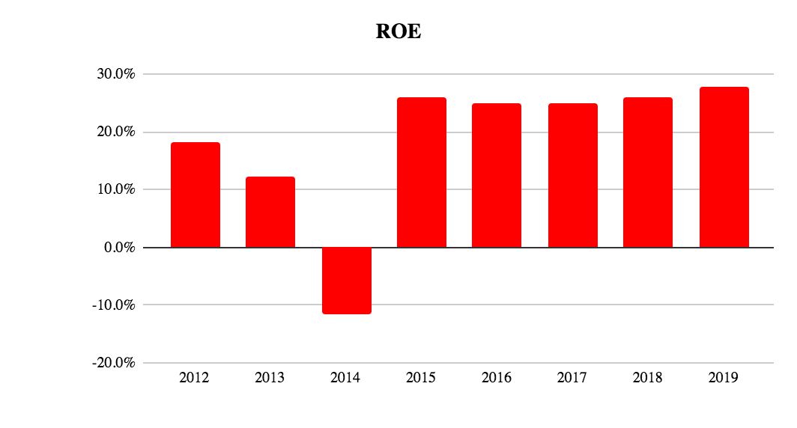
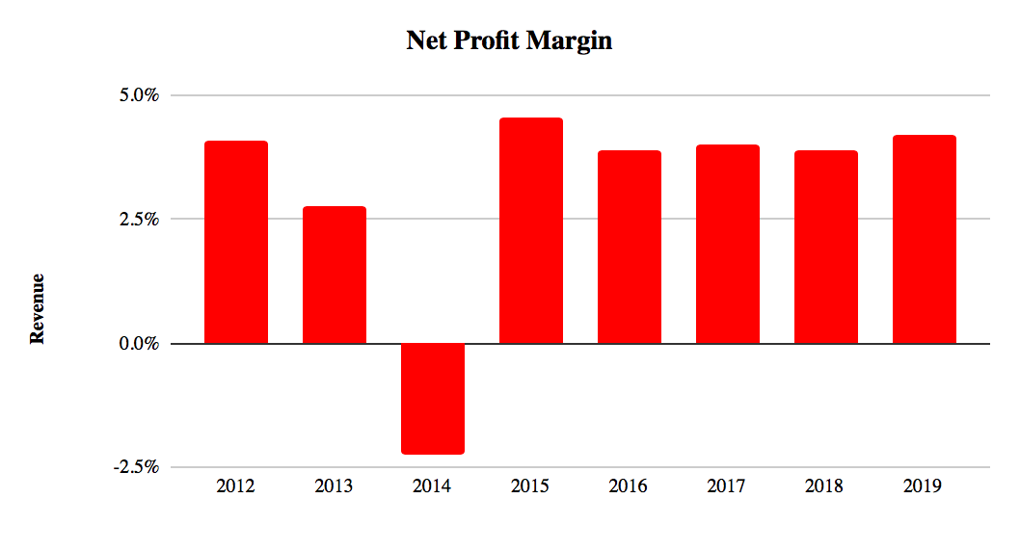
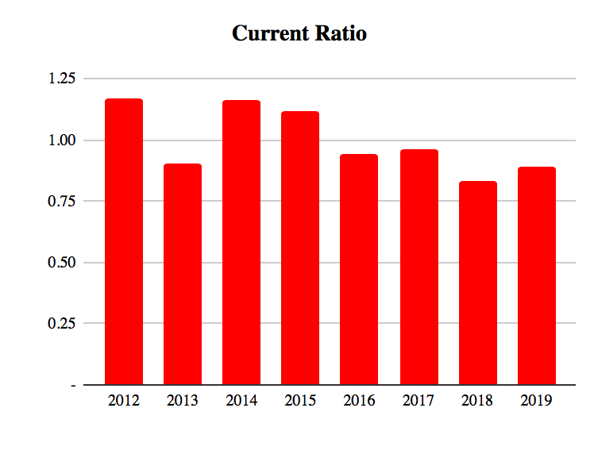
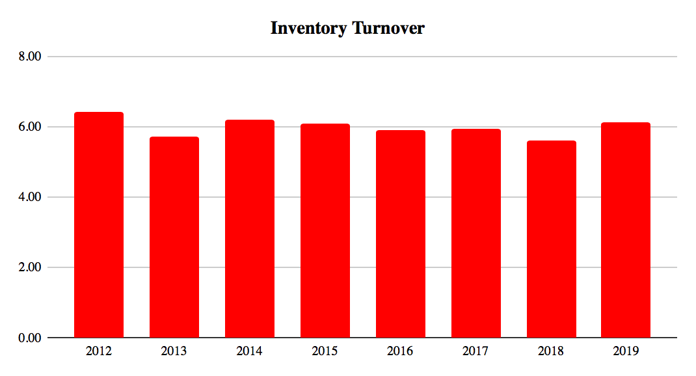
Target Corp. - Ratio and Trend Analysis

Slide 16
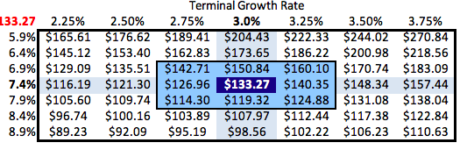
Target Corp. - DCF Analysis
Key Assumptions
Used Averaged beta because COVID-19 increased the overall uncertainty of economic conditions in the future Revenue model is by different merchandise revenue sources Covid-19 will have negative impact on 2020 sales, COGS and SG&A Assume higher growth on Household essentials and Food, lower growth on hardline, and no growth on apparel and Decor. 7.4% Discount rate, 3.0% Terminal Growth
Sensitivity Analysis
Cost of Equity
Worst Case: $ 101
Base Case: $ 133
Best Case: $ 189
Recession
Low consumer confidence
Online competition
Affected by COVID-19 but recover
Consumer Spending shift toward DIY
Growing Demand on groceries
Higher margin on store brands

Slide 17
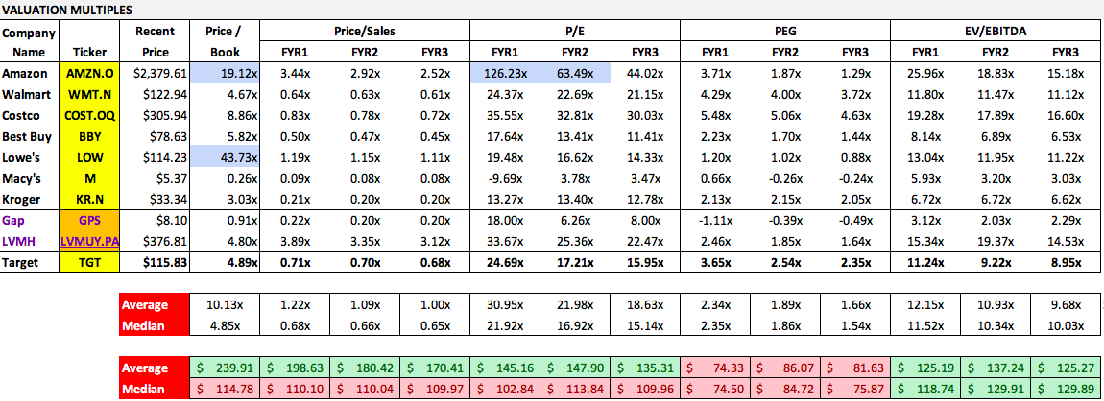
Target Corp. - Comparisons

Slide 18
Recommendation
Recommendation Summary
Mean Recommendation (this week): | 2.2
Mean Recommendation (last week): | 2.2
Change: | 0
Price Target Summary
Mean Target | $121.72
Median Target | $121.00
High Target | $150.00
Low Target | $83.00
No. of Analysts | 28
BUY
Covid-19 has done tremendous damage globally to the retail industry, however, consumer stables segment is relatively strong during economic downtowns. Target positioned itself well in the pandemic and had potential to harvest larger sales thanks to people’s shopping habit shifted after the country lock-down. Its solid financial and efficiency stance together with its well executed strategy will help Target stay competitive in the unprecedented time.

Slide 19
Questions?

Slide 21
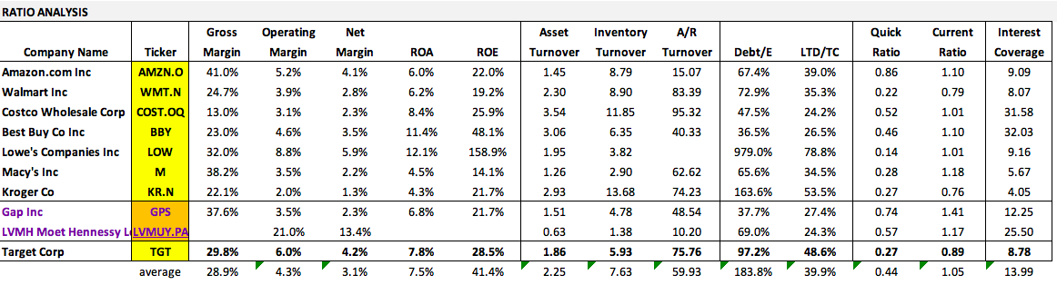
Notes

